Slide 1
THE EUROPEAN ECONOMY IN THE MEDIUM TERM
Ville Kaitila & Markku Lehmus
Report prepared by ETLA and presented at AIECE spring meeting in
The Hague 9-10 May 2019

Slide 2
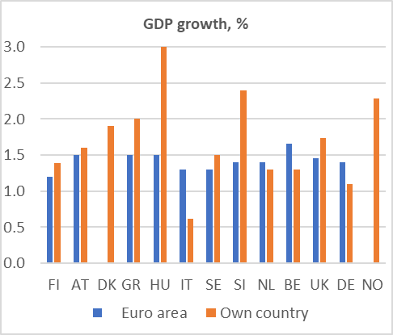
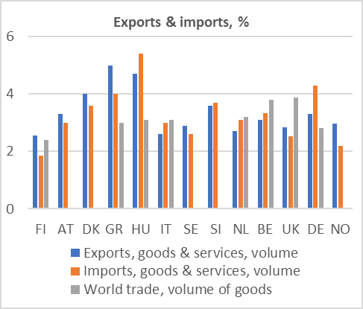
Average growth in 2019-2023 in AIECE member countries
World GDP growth in 2019-23 as fast as in 2014–18. Growth in global goods exports is expected to pick up. However, GDP growth in the EU to slow down.
IT and DE slowest GDP growth; HU and SI fastest.
Growth faster in the US. N.B.: demographics.
Export growth fastest in GR and HU (DK and SI)
Exports vs. Imports
Expected growth in world trade 2.4 – 3.9%.
Sources: AIECE member institutes.

Slide 3
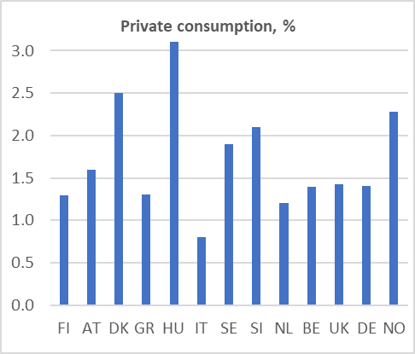
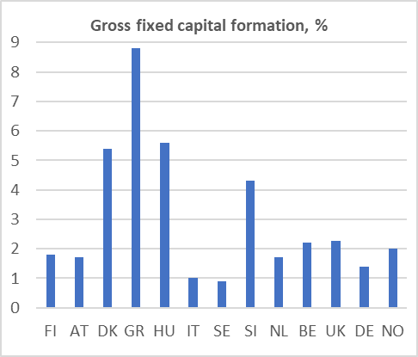
Average growth in 2019-2023 in AIECE member countries
Private consumption growth in HU, DK, NO, SI, SE.
Weak in IT.
Investment growth in GR, HU, DK, SI.
Weak in IT, SE.
Sources: AIECE member institutes.

Slide 4
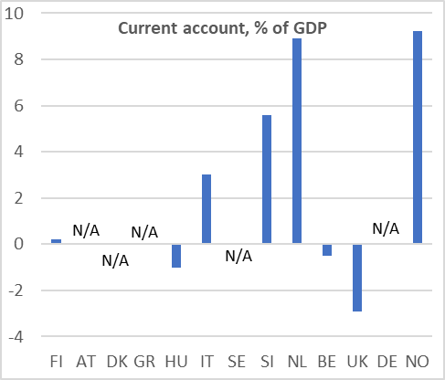
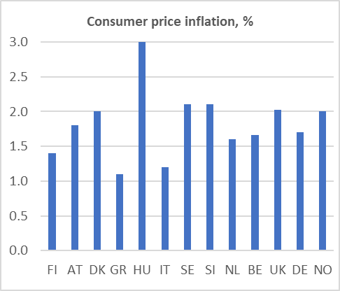
Average growth in 2019-2023 in AIECE member countries
Strong current account in NL, NO, SI.
Price convergence: HU.
Weak domestic demand in GR, IT.
Sources: AIECE member institutes.

Slide 5
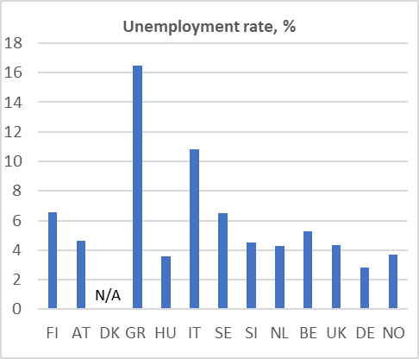
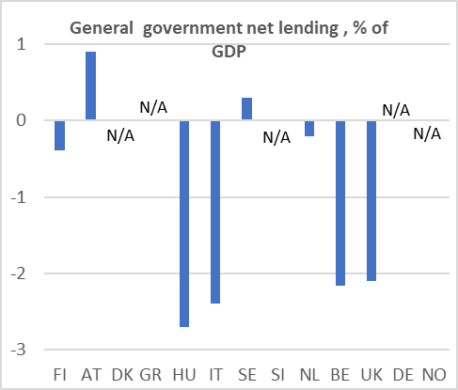
Average growth in 2019-2023 in AIECE member countries
Continuing high unemployment GR, IT.
Relatively high structural unemployment also in FI, SE.
Large public sector deficits in HU, IT, BE, UK
Sources: AIECE member institutes.

Slide 6
Next 5 y
relative
to last 5
Forecasts for the EU
 | 2014 – 2018 | 2019 – 2023 | Min | Max
GDP (vol.)
Euro area | 1.9 | 1.4 | 1.2 | 1.5
EU | 2.1 | 1.6 | 1.3 | 1.8
Private consumption (vol.)
Euro area | 1.5 | 1.3 | 1.1 | 1.5
EU | 1.9 | 1.7 | 1.6 | 1.8
Public consumption (vol.)
Euro area | 1.2 | 1.2 | 0.9 | 1.5
EU | 1.2 | 1.2 | 1.0 | 1.3
Gross fixed investment (vol.)
Euro area | 3.3 | 2.3 | 1.9 | 2.8
EU | 3.4 | 2.5 | 1.9 | 3.0
Exports of goods and services (vol.)
Euro area | 4.5 | 2.9 | 2.4 | 4.0
EU | 4.5 | 3.5 | 2.5 | 4.5
Imports of goods and services (vol.)
Euro area | 4.7 | 3.1 | 2.5 | 4.0
EU | 4.8 | 3.6 | 2.5 | 4.5
HICP (Consumer price inflation)
Euro area | 0.8 | 1.7 | 1.5 | 2.0
EU | 0.9 | 2.0 | 1.7 | 2.7
Unemployment rate
Euro area | 10.0 | 7.5 | 6.5 | 8.0
EU | 8.2 | 6.5 | 5.4 | 7.0

Slide 7
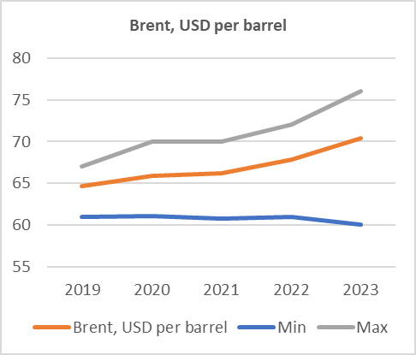
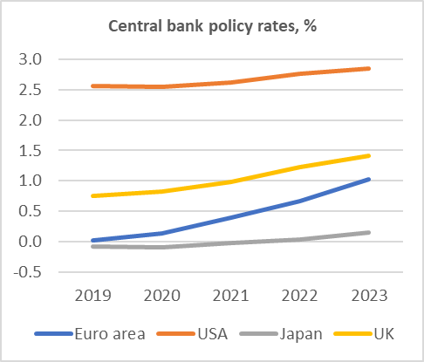
Crude oil & policy rates
 | 2014- 2018 | 2019 | 2020 | 2021 | 2022 | 2023
Brent, USD per barrel | 64.9 | 65 | 66 | 66 | 68 | 70
Central bank policy rates, % |  | 2019 | 2020 | 2021 | 2022 | 2023
- Euro area |  | 0.0 | 0.1 | 0.4 | 0.7 | 1.0
- USA |  | 2.6 | 2.5 | 2.6 | 2.8 | 2.9
- Japan |  | -0.1 | -0.1 | 0.0 | 0.0 | 0.2
- UK |  | 0.8 | 0.8 | 1.0 | 1.2 | 1.4

Slide 8
Country questions: Fiscal policy measures to improve growth in the next five years
According to respondents, authorities have taken some decisions to improve growth in the next five years in the AIECE member countries
- lowering unit labor cost with a competitiveness pact (Finland)
- citizenship income (Italy)
- higher social spending and higher wages in the public sector (Slovenia)
- tax cuts and outlay increases (the Nertherlands)
- higher spending, in particular on health service (the UK)
- automatic inflation adjustment of income tax thresholds (Germany)
- tax cuts (Norway)

Slide 9
Structural policy measures to improve growth in the next five years in the AIECE member countries
On tructural policy measures
- A pension reform, implemented already in 2015 (Finland)
- privatisation and utilisation of public assets (Greece)
- a reduction in labour taxes (Slovenia)
- “efficiency measures” (Norway)

Slide 10
Fiscal policy measures that impair growth in the next five years in the AIECE member countries
However decisions also to impair growth in the medium run
- expiring investment incentives (Italy)
- a scheduled reduction of tax free income in 2020 (Greece)
- increased taxation of capital and corporates (Slovenia)
- cuts in education investments (Finland)
- continued ambition to keep spending in most areas unchanged in real
terms (the UK)
- increase in the fiscal burden by expanding pension liabilities (Germany)
- lower growth in public consumption and investments together with
increased inequality and fiscal evasion (Norway)

Slide 11
Risks to growth in the medium run in the AIECE member countries
Six out of 13 institutes that answered the questionnaire judged Brexit a serious risk to economic growth for their respective country. Only institutes in Switzerland and Italy do not consider Brexit an important risk to their countries’ growth.
Also, institutes in 4 out of the 13 countries assess an increase in oil prices a significant risk to their economic growth.
From other sources of risks, institutes from Switzerland and Italy consider a renewed sovereign debt crisis in the euro area a very important risk to growth in their countries

Slide 12
Risks to growth in the medium run in the AIECE member countries
10 out of 13 respondents from different institutes saw the US trade policy a very damaging factor for their countries’ growth in the medium term. This was considered especially detrimental for growth in Finland, Norway and Greece.
Also, a wide consensus was found on the significance of risk coming from a slow-down in the world economy. Only one institute (from the Netherlands) did not see this as an important factor contributing to their medium-term growth.
The rise in populism is judged a moderate risk by most institutes; the rise in populism is assessed a very serious risk to economic growth only in the Netherlands.

Slide 13
Competitivity issues (in the AIECE member countries)
Productivity is seen as the most important factor determining competitiveness in the medium run, according to the institutes that answered the questionnaire.
Institutes also stressed the importance of unit labour costs in determining competitiveness.
The industrial structure is seen almost equally important, according to answers by the institutes from Norway and Ireland.
Institutes from Switzerland and Sweden also raise the exchange rate as an important factor determining their countries’ competitiveness in the medium run.

Slide 14
Competitivity issues
Only the institutes from Switzerland, Hungary and Germany think that infrastructure investments in their home countries are sufficient (sufficient defined here at the scale from 6 to 10).
Instead, the institutes from the UK and Norway considered the infrastructure investments in their country being close to completely insufficient.
- When asked to name the biggest constraint on infrastructure investments,
the answers ranged from long building procedures to lack of skilled labour,
public debt issues and privatisation.

Slide 15
IMF (2014) finds that the stock of public capital has declined significantly relative to output over the past three decades across advanced and developing economies.

Slide 16
Competitivity: public investments
It is possible to argue that countries that have under-invested in infrastructure and yet have reasonable, well-defined investment plans, meaning that it can be shown that these could improve potential output, should seize the opportunities provided by low real interest rates.
IMF World Economic Outlook (2014) finds that, for a sample of advanced countries, a one percentage point of GDP increase in public investments could increase GDP by about 0.4 per cent in the same year and by 1.5 per cent after four years.

Slide 17
Competitivity: R&D activities and demographics
Five out of the 13 institutes that answered the questionnaire judge that public involvement in re-search and development (R&D) activities is well organised and financially sufficient in their home countries (scores between 6 and 10). The opposite position – completely insufficient – was taken by institutes from Norway, Greece and Hungary.
Six respondents assessed that from the fiscal point of view, their home country is sufficiently prepared to meet the challenge of lower labour force growth (scores between 6 and 10). On the other hand, institutes from Greece and the UK find that their countries are quite unprepared for the demographic challenge.
- The 2018 Ageing report finds that the EU’s old-age dependency ratio (people
aged 65 and above relative to those aged 15 to 64) is expected to increase by
21.6 percentage points, from 29.6% in 2016 to 51.2% in 2070.

Slide 18
Competitivity: financial system
Ten respondents assessed that the financial system in their country is relatively stable (scores between 6 and 10). Worries concerning the stability range from non-performing bank loans to low banking sector profitability, housing prices and renewed euro crisis (combined with a banking crisis).
- However, none of the institutes judges the current state of the financial
system in their country particularly unstable.

Slide 19
EU-related questions
Six out of nine respondents think that the weak economic development in the EU can be associated with the secular stagnation hypothesis (association defined an answers being ranging between 6 and 10)
- Interestingly, the weights given for the relevance of the secular stagnation
hypothesis range between 3 (institute from Germany) and 9 (institute
from Italy), hence not all institutes share the view of importance of the
hypothesis. On average, respondents believe in the secular stagnation
hypothesis with an intensity score of 6.4.

Slide 20
EU-related questions: the ECB’s mandate
Six out of ten respondents assess that the current ECB mandate is appropriate
- Those respondents that do not share this view comment, for instance, that
beyond price stability, the ECB's target should include economic growth
and employment.
- In addition, one respondent remarks that the current mandate focuses too
little on imbalances (financial and distribution wise).
If not changing the whole mandate, – which is a delicate and complicated issue –, one step ahead could be a reassessment of the monetary policy tool pack available for the ECB – an idea supported for instance by Olli Rehn, candidate for the ECB’s next president. He has also mooted an idea of letting inflation run above its target for a limited period.
Villeroy de Galhau, governor of the Banque de France, has instead proposed compensating banks for charges associated with negative interest rates.

Slide 21
EU-related questions: fiscal policy
Four out of eight respondents argue that the current fiscal policy stance in the EU is appropriate, whereas three institutes judge that it is too contractionary. Only one institute argues that the current fiscal policy stance is too expansionary.
- Thus, it is possible to infer that, on average, institutes lean to the
view that the fiscal policy stance in the EU is perhaps slightly too
contractionary.
Most of the institutes assess that the current fiscal rules in the EU are not appropriate. However, three out of nine institutes assess that the fiscal rules themselves are well-defined, but it is their implementation, instead, which is the problem while the EU Commission lacks the enforcement ability.

Slide 22
EU-related questions
To enhance convergence: increase competition in the internal market (average of 6.7, range 1-9), EU-wide investment programmes (6.5 points, range 3-10), use regional policy instruments in the EU budget (6.3 points, range 3-10), harmonising national tax policies (3.6 points, range 1-8). A lot of variation in the responses.
Probability of a systemic risk in EU financial markets in the medium term: 24 per cent (range 0-40%).
How worrying are asset price bubbles? Score of 6.7 points (range 5-10). So, rather worried.
Brexit at the end of this year? The answers were ‘all over the place’. Likeliest: A new deal, a further delay, or no deal. Weakest support: revoking Article 50 and Ms May’s deal.
Will Brexit change member countries’ support for greater cooperation within existing EU institutions. The average of the probabilities: no change (54%), increase (34%), decrease (31%).

Slide 23
Thank you for your answers and your interest

